Slide 1


CITS1003 Introduction to Cybersecurity [7] Incidents exercises
Dr Zhi Zhang

Slide 2
Automation
CALDERA
ADTool

Slide 3
CALDERA
cyber range simulates real-world network environment that can be used to replicate real-world cyber scenarios.
red team is a group of security professionals who simulate cyber attacks and thus identify weaknesses that can be exploited by real attackers
blue team is a group of security professionals who respond to the simulated attacks and test their incident responses.

Slide 4
CALDERA
CALDERA provides a cyber-range environment.
A red team can automate simulated attacks that are modelled from real-world threat actors, identify weaknesses in a target organization’s network and test the incident-response mechanisms that are deployed.
A blue team can inspect the effectiveness of their deployed defenses and incident-response mechanisms, thus improving their incident response capabilities, better preparing for real-world cyber threats and mitigating the risks associated with cyber attacks.

Slide 5
CALDERA
Installation
Open a Linux VM
Run the following commands:
sudo apt install python3-pip
git clone https://github.com/mitre/caldera.git --recursive
cd caldera
pip3 install -r requirements.txt
python3 server.py --insecure

Slide 6
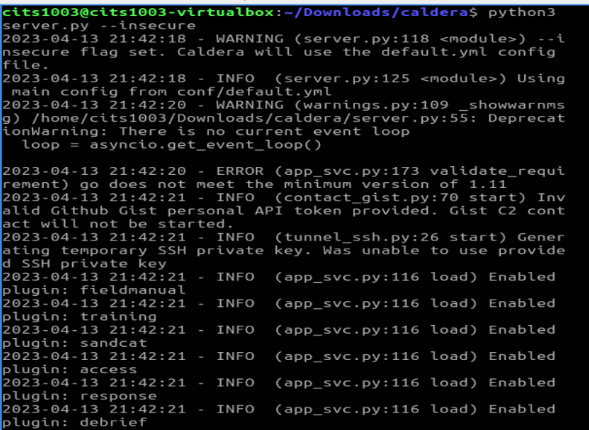
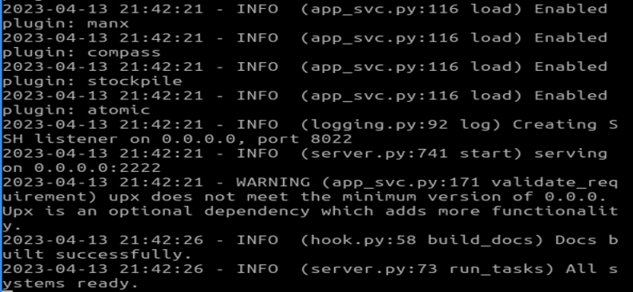

Slide 7
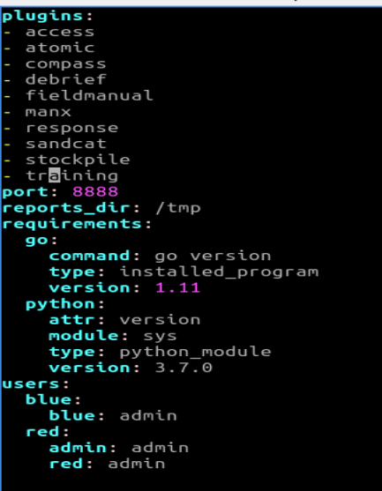
CALDERA
Login
In caldera/conf/default.vml,

Slide 8
CALDERA
Login
Open a browser
Enter the following URL in the address bar
http://localhost:8888
username: red
password: admin

Slide 9
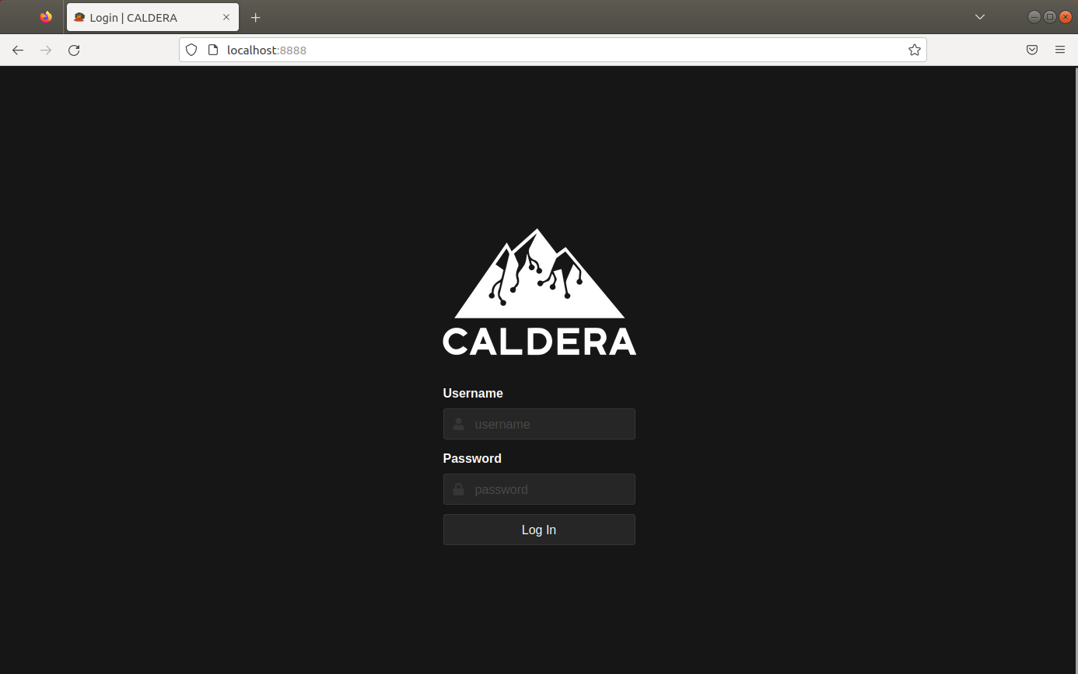
CALDERA

Slide 10
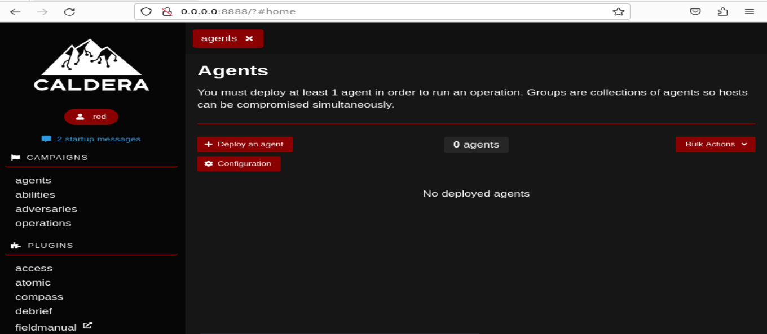
CALDERA

Slide 11
CALDERA
Adversary is a profile of instructions that describe various TTPs (Tactics, Techniques and Procedures) to be performed on a targeted system. An adversary profile can be used to simulate an attack automatically.

Slide 12
CALDERA
Tactics: high-level goals or objectives that attackers aim to achieve.
e.g., gaining unauthorized access.
Techniques: specific methods used by attackers to achieve their tactics.
e.g., exploiting vulnerabilities.
Procedures: step-by-step processes followed by attackers when executing their techniques.
e.g., specific commands.

Slide 13
CALDERA
Adversary is a profile of instructions that describe various TTPs to be performed on a targeted system. An adversary profile can be used to simulate an attack automatically.
Agent works as a spy program that is installed on the targeted system and responsible for executing TTPs specified in the adversary profile.

Slide 14
CALDERA
Adversary is a profile of instructions that describe various TTPs to be performed on a targeted system. An adversary profile can be used to simulate an attack automatically.
Agent works as a spy program that is installed on the targeted system and responsible for executing TTPs specified in the adversary profile.
Ability is a specific implementation of a tactic/technique including what commands to run and what OS the commands can run on.
e.g., display information about running processes in Linux by running ``ps –aux”

Slide 15
CALDERA
Adversary is a profile of instructions that describe various TTPs (tactics, techniques and procedures) to be performed on a targeted system. An adversary profile can be used to simulate an attack or evaluate the effectiveness of a security defense.
Agent works as a spy program that is installed on the targeted system and responsible for executing TTPs specified in the adversary profile.
Ability is a specific implementation of a tactic/technique including what commands to run and what OS the commands can run on.
Operation is to create an adversary profile and executes the profile via agent.

Slide 17
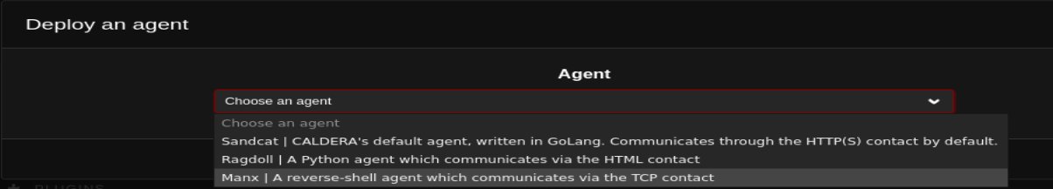

Slide 18
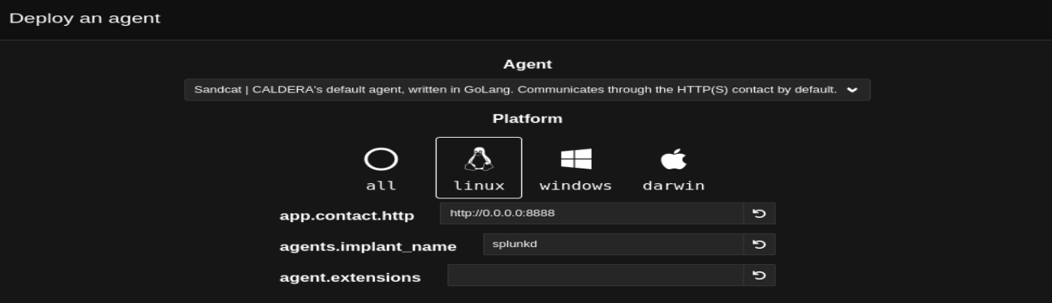
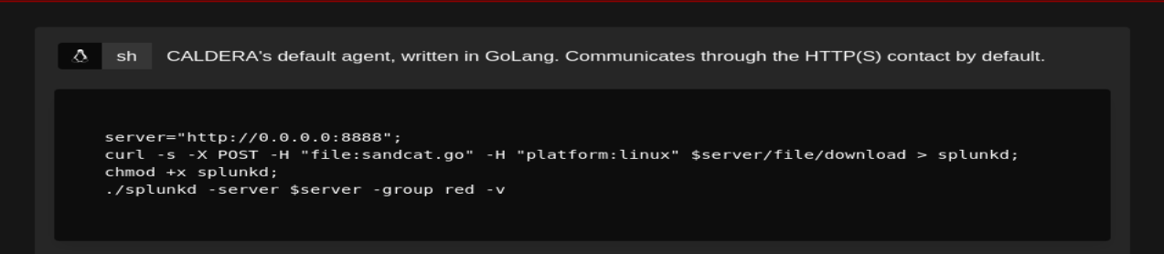

Slide 19

agent.sh

Slide 20
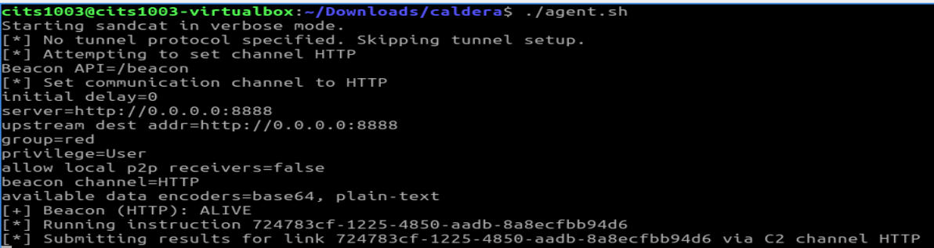

Slide 21
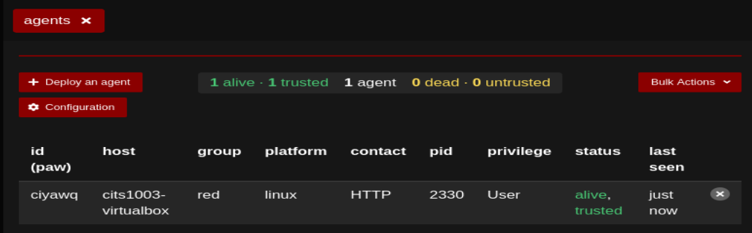

Slide 22
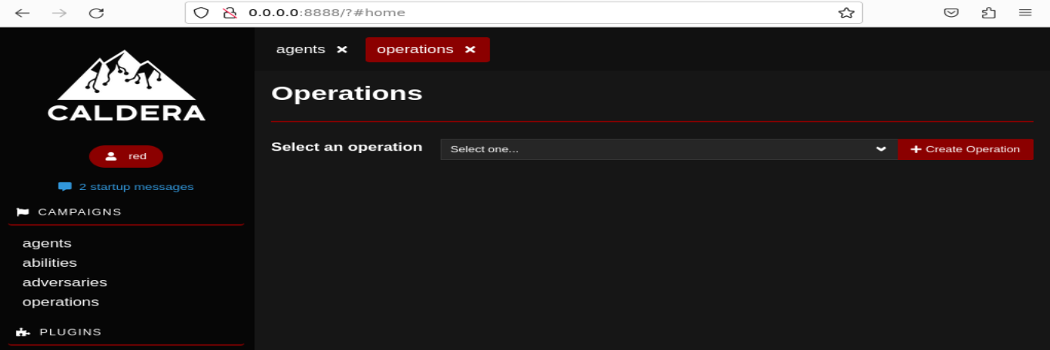

Slide 23
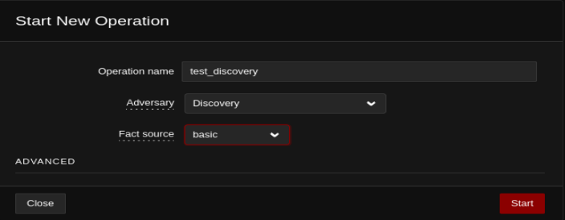

Slide 24
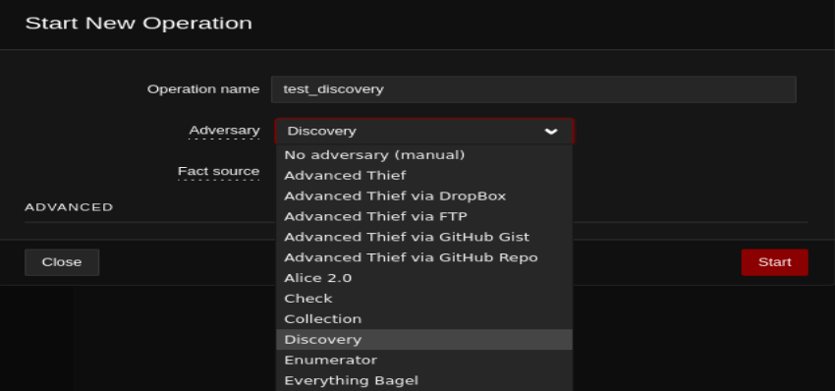

Slide 25
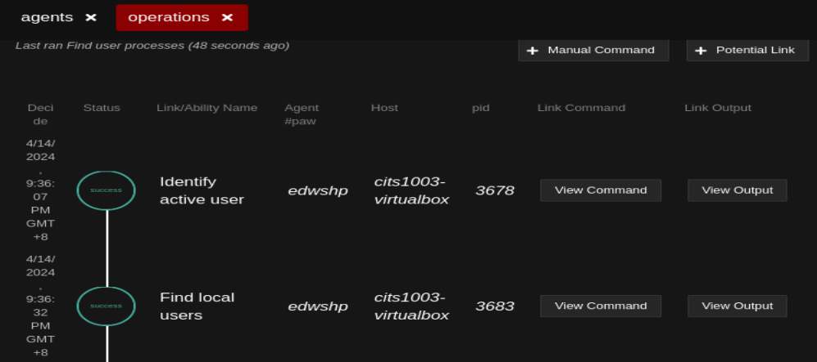

Slide 26
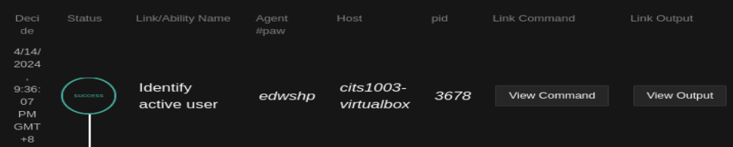
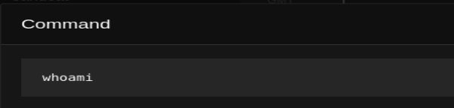
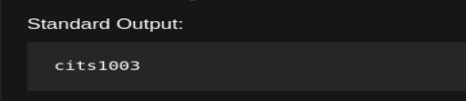

Slide 27
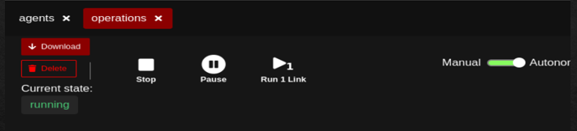
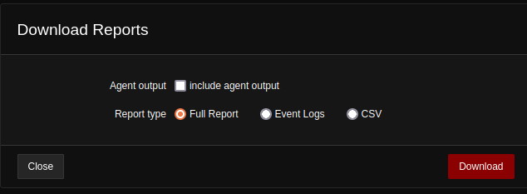

Slide 28
CALDERA
Demo

Slide 29
ADTool
What is ADTool?
ADTool, short for Attack-Defense Tree Tool, allows a user to model and analyze attack-defense scenarios using attack-defense trees.

Slide 30
ADTool
Installation
Download JDK (Java Development Kit): https://www.oracle.com/java/technologies/downloads/
Filename: jdk-17_windows-x64_bin.exe
Install JDK
Double click the exe file

Slide 31
ADTool
Installation
Download JDK
Install JDK
Download ADTool: https://satoss.uni.lu/members/piotr/adtool/
Filename: ADTool-1.4-jar-with-dependencies.jar

Slide 32
ADTool
Installation
Download JDK
Download ADTool
Run the tool
Open PowerShell from the directory where the tool is downloaded
Run this command: java –jar .\ADTool-1.4-jar-with-dependencies.jar

Slide 33
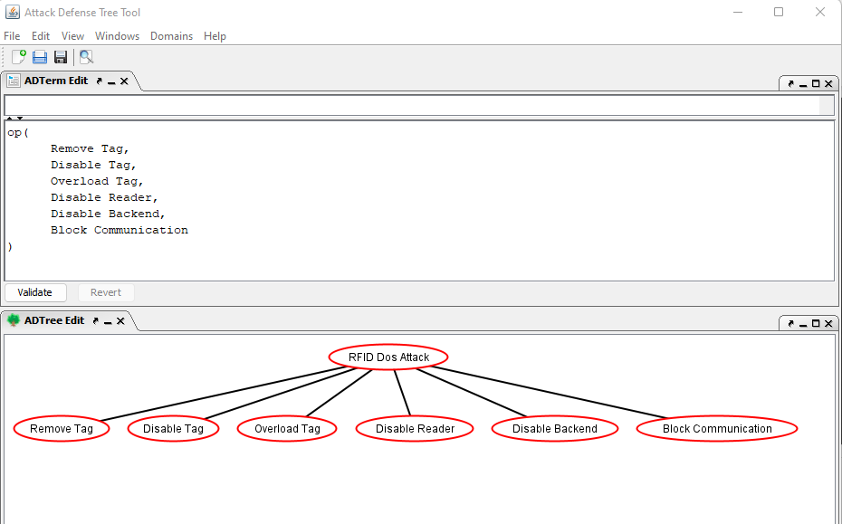

Slide 34
or proponents

Slide 35
or proponents
or
proponents

Slide 36
RFID: Radio Frequency Identification
RFID Tag:
RFID Reader
RFID Backend Server

Slide 37

RFID Tag
RFID Reader
RFID Backend Server
Tag attachment: every RFID tag, denoting a unique identifier (UID), is attached to an asset.
Reader installation: every RFID reader is installed in locations where assets pass through. These readers continuously look for RFID tags by emitting radio frequency signals.
Tag detection: When an asset passes within a range of the reader, its attached tag is detected. The tag sends its UID and geographic location to the reader. The reader then sends the information to an RFID backend server.
Server processing: The RFID backend server processes the information by verifying the tag's identity, updating the asset's location, etc.

Slide 39
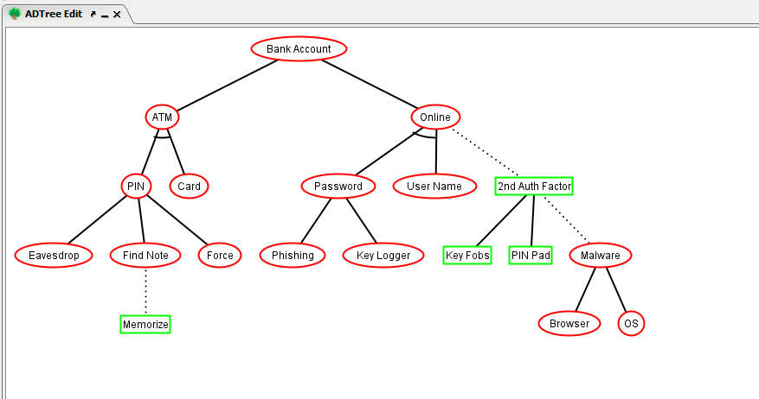
or proponents
op
op
op

Slide 40
op: or proponents
ap: and proponents
ap
?
op
op
?
?
op
?

Slide 41
op: or proponents
ap: and proponents
ap
?
opponent
op
op
oo: or opponents
?
opponent
opponent
op
?
opponent

Slide 42
op: or proponents
ap: and proponents
ap
cp
opponent
op
op
oo: or opponent
co: counter opponent
opponent
opponent
op
cp: counter proponent
opponent

Slide 43
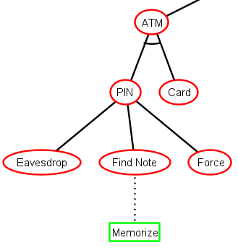
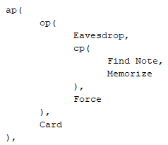

Slide 44
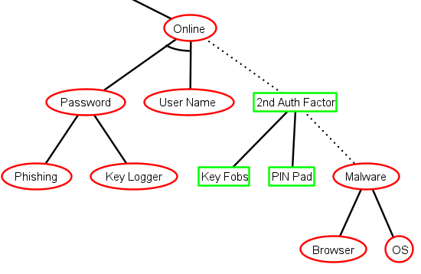
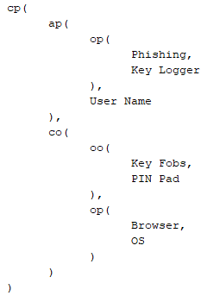

Slide 45
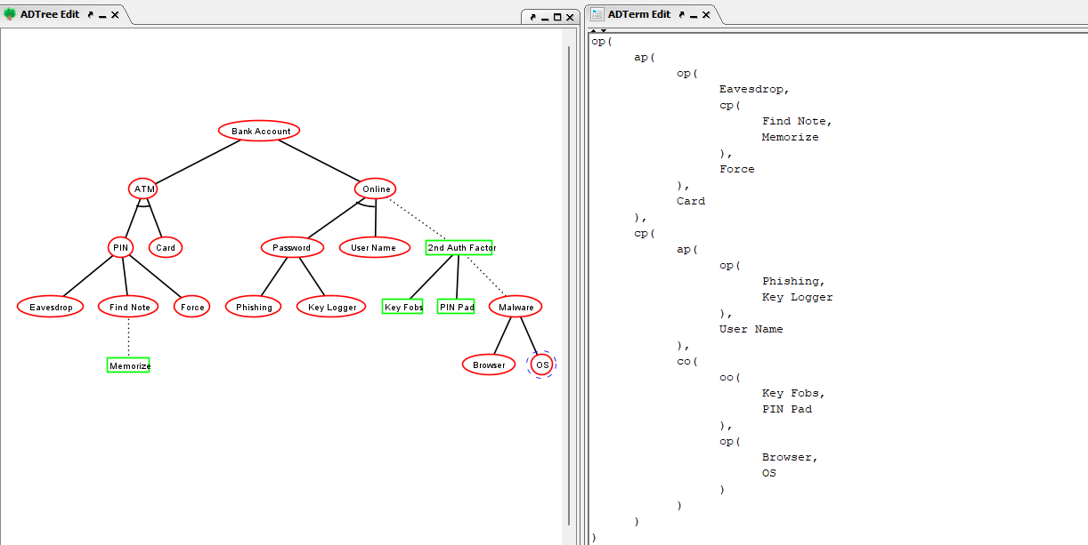

Slide 46
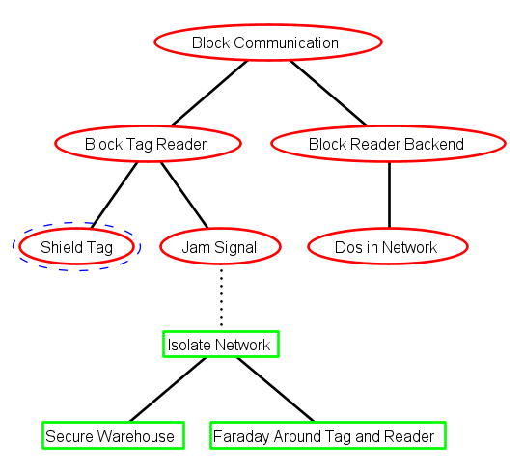
Exercise (tree translation)

Slide 47
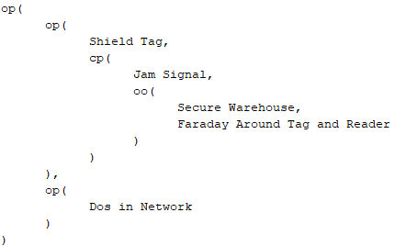
Exercise (tree translation)

Slide 48
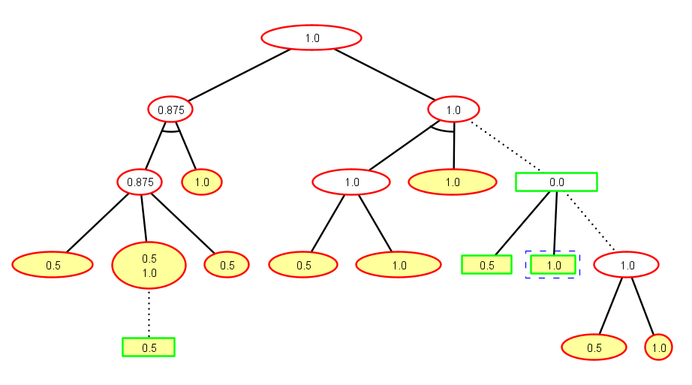
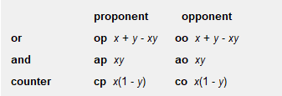
Exercise (success probability for the nodes)
0.75
1.0
0.0
1.0
0.5

Slide 49
Exercise (success probability for the nodes)
0.75
1.0
0.0
1.0
0.5

Slide 50
Exercise (success probability for the nodes)
0.75
1.0
0.0
1.0
0.5

Slide 51
Exercise (success probability for the nodes)
0.75
1.0
0.0
1.0
0.75
0.5

Slide 52
Exercise (success probability for the nodes)
0.75
1.0
0.0
0.75+0.5-0.75*0.5
1.0
0.5

Slide 53
Exercise (success probability for the nodes)
0.75
1.0
0.0
0.75+0.5-0.75*0.5
1.0
0.5

Slide 54
Exercise (success probability for the nodes)
0.75
1.0
0.0
0.75+0.5-0.75*0.5
1.0
0.75
0.5

Slide 55
Exercise (success probability for the nodes)
0.75
1.0
0.0
0.75+0.5-0.75*0.5
1.0
0.75
0.5

Slide 56
Exercise (success probability for the nodes)
0.75
1.0
0.25
0.75+0.5-0.75*0.5
1.0
0.75
0.5

Slide 57
Exercise (success probability for the nodes)
0.75
1.0
0.25
0.75+0.5-0.75*0.5
1.0
0.75
0.5

Slide 58
Exercise (success probability for the nodes)
0.75
1.0
0.25
0.75+0.5-0.75*0.5
1.0
0.75
0.5

Slide 59
Exercise (success probability for the nodes)
0.75
1.0
0.25
0.75+0.5-0.75*0.5
1.0
0.75
0.5

Slide 60
Exercise (success probability for the nodes)
0.875+0.75-0.875*0.75
0.96875
0.75
1.0
0.25
0.75+0.5-0.75*0.5
1.0
0.75
0.5

